Slide 1




Better data, better hospitals
Activity 3: Difficult to easy
Which graph is best?

Slide 2
Clustered column graph

Slide 3
Pie graph

Slide 4
Stacked area graph

Slide 5
Heat-map
Year level | Walk | Bus | Bike | Driven in car | Drive yourself
Year 7
Year 8
Year 9
Year 10
Year 11
Year 12

Slide 6
3-D line graph

Slide 7
Radar graph

Slide 8
Stop here
Make your own heat-map

Slide 9
Completed heat-map
 |  |  |  |  |  |  |  | Daily hospital admissions March 2008
Hour of day | 1 | 2 | 3 | 4 | 5 | 6 | 7 | 8 | 9 | 10 | 11 | 12 | 13 | 14 | 15 | 16 | 17 | 18 | 19 | 20 | 21 | 22 | 23 | 24 | Daily Total
01-Mar-08 |  |  |  |  |  |  |  |  |  |  |  |  |  |  |  |  |  |  |  |  |  |  |  |  | 51 | Saturday | 0
02-Mar-08 |  |  |  |  |  |  |  |  |  |  |  |  |  |  |  |  |  |  |  |  |  |  |  |  | 55 | Sunday | 1
03-Mar-08 |  |  |  |  |  |  |  |  |  |  |  |  |  |  |  |  |  |  |  |  |  |  |  |  | 40 | Monday | 2
04-Mar-08 |  |  |  |  |  |  |  |  |  |  |  |  |  |  |  |  |  |  |  |  |  |  |  |  | 56 | Tuesday | 3
05-Mar-08 |  |  |  |  |  |  |  |  |  |  |  |  |  |  |  |  |  |  |  |  |  |  |  |  | 35 | Wednesday | 4
06-Mar-08 |  |  |  |  |  |  |  |  |  |  |  |  |  |  |  |  |  |  |  |  |  |  |  |  | 57 | Thursday | 5
07-Mar-08 |  |  |  |  |  |  |  |  |  |  |  |  |  |  |  |  |  |  |  |  |  |  |  |  | 56 | Friday | 6
08-Mar-08 |  |  |  |  |  |  |  |  |  |  |  |  |  |  |  |  |  |  |  |  |  |  |  |  | 50 | Saturday | 7
09-Mar-08 |  |  |  |  |  |  |  |  |  |  |  |  |  |  |  |  |  |  |  |  |  |  |  |  | 43 | Sunday | 8
10-Mar-08 |  |  |  |  |  |  |  |  |  |  |  |  |  |  |  |  |  |  |  |  |  |  |  |  | 35 | Monday | 9
11-Mar-08 |  |  |  |  |  |  |  |  |  |  |  |  |  |  |  |  |  |  |  |  |  |  |  |  | 51 | Tuesday | 10
12-Mar-08 |  |  |  |  |  |  |  |  |  |  |  |  |  |  |  |  |  |  |  |  |  |  |  |  | 48 | Wednesday
13-Mar-08 |  |  |  |  |  |  |  |  |  |  |  |  |  |  |  |  |  |  |  |  |  |  |  |  | 49 | Thursday
14-Mar-08 |  |  |  |  |  |  |  |  |  |  |  |  |  |  |  |  |  |  |  |  |  |  |  |  | 42 | Friday
15-Mar-08 |  |  |  |  |  |  |  |  |  |  |  |  |  |  |  |  |  |  |  |  |  |  |  |  | 36 | Saturday
16-Mar-08 |  |  |  |  |  |  |  |  |  |  |  |  |  |  |  |  |  |  |  |  |  |  |  |  | 40 | Sunday
17-Mar-08 |  |  |  |  |  |  |  |  |  |  |  |  |  |  |  |  |  |  |  |  |  |  |  |  | 53 | Monday
18-Mar-08 |  |  |  |  |  |  |  |  |  |  |  |  |  |  |  |  |  |  |  |  |  |  |  |  | 46 | Tuesday
19-Mar-08 |  |  |  |  |  |  |  |  |  |  |  |  |  |  |  |  |  |  |  |  |  |  |  |  | 56 | Wednesday
20-Mar-08 |  |  |  |  |  |  |  |  |  |  |  |  |  |  |  |  |  |  |  |  |  |  |  |  | 53 | Thursday
21-Mar-08 |  |  |  |  |  |  |  |  |  |  |  |  |  |  |  |  |  |  |  |  |  |  |  |  | 51 | Friday
22-Mar-08 |  |  |  |  |  |  |  |  |  |  |  |  |  |  |  |  |  |  |  |  |  |  |  |  | 56 | Saturday
23-Mar-08 |  |  |  |  |  |  |  |  |  |  |  |  |  |  |  |  |  |  |  |  |  |  |  |  | 47 | Sunday
24-Mar-08 |  |  |  |  |  |  |  |  |  |  |  |  |  |  |  |  |  |  |  |  |  |  |  |  | 45 | Monday
25-Mar-08 |  |  |  |  |  |  |  |  |  |  |  |  |  |  |  |  |  |  |  |  |  |  |  |  | 47 | Tuesday
26-Mar-08 |  |  |  |  |  |  |  |  |  |  |  |  |  |  |  |  |  |  |  |  |  |  |  |  | 40 | Wednesday
27-Mar-08 |  |  |  |  |  |  |  |  |  |  |  |  |  |  |  |  |  |  |  |  |  |  |  |  | 49 | Thursday
28-Mar-08 |  |  |  |  |  |  |  |  |  |  |  |  |  |  |  |  |  |  |  |  |  |  |  |  | 42 | Friday
29-Mar-08 |  |  |  |  |  |  |  |  |  |  |  |  |  |  |  |  |  |  |  |  |  |  |  |  | 41 | Saturday
30-Mar-08 |  |  |  |  |  |  |  |  |  |  |  |  |  |  |  |  |  |  |  |  |  |  |  |  | 38 | Sunday
31-Mar-08 |  |  |  |  |  |  |  |  |  |  |  |  |  |  |  |  |  |  |  |  |  |  |  |  | 32 | Monday

Slide 10
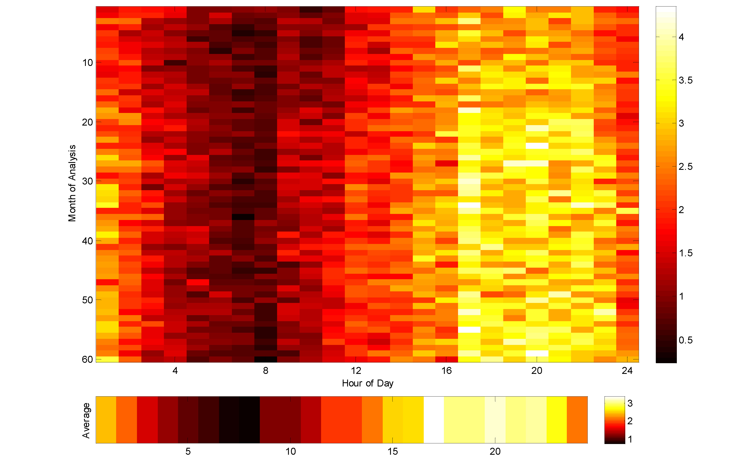
Treatment times for those leaving the ED

Slide 11
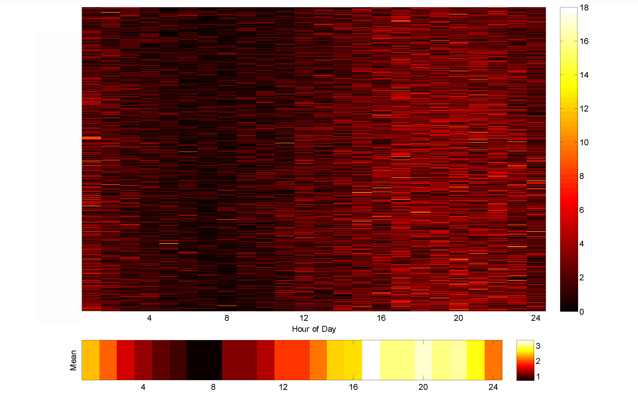
Admission times for the ED

Slide 12
Investigating the Maths Inside
Maths Inside is a project led by University of Technology Sydney, and funded by the Commonwealth Department of Education and Training under the Australian Maths and Science Partnership Program.
The aim of Maths Inside is to increase engagement of secondary school students
in mathematics, by using rich tasks that show the ways it is used in real world applications. To find out more about this project and other AMSPP resources,
please go to http://dimensions.aamt.edu.au
© Maths Inside 2016 except where otherwise indicated. This document may be
used, reproduced, communicated and adapted free of charge for non-commercial educational purposes provided all acknowledgements associated with the material are retained. Maths Inside is a UTS project in collaboration with CSIRO and AAMT.

