Slide 1




Investigating the Maths Inside
Cleaner coasts

Slide 2
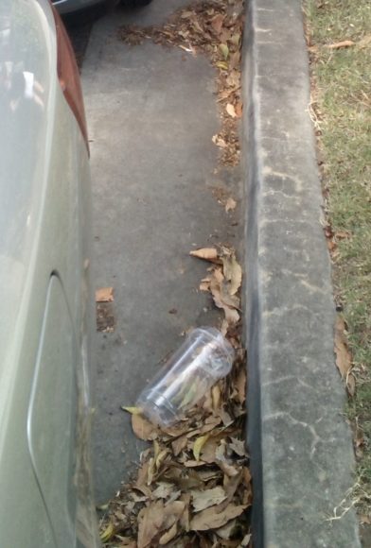
From shop to shore
Plastic containers dropped on the ground often end up in the gutter on the side of the road.

Slide 3
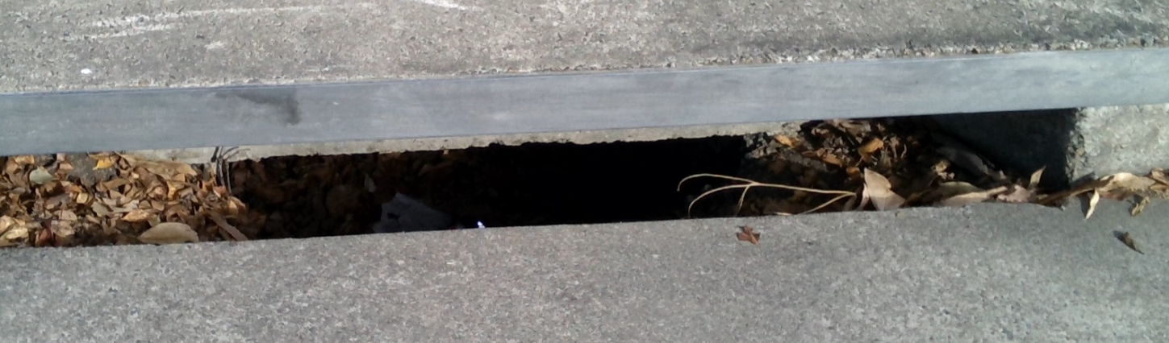
From shop to shore
Next time it rains heavily, the plastic might get washed down a drain. Stormwater drains like this are connected to pipes which flow downhill.

Slide 4
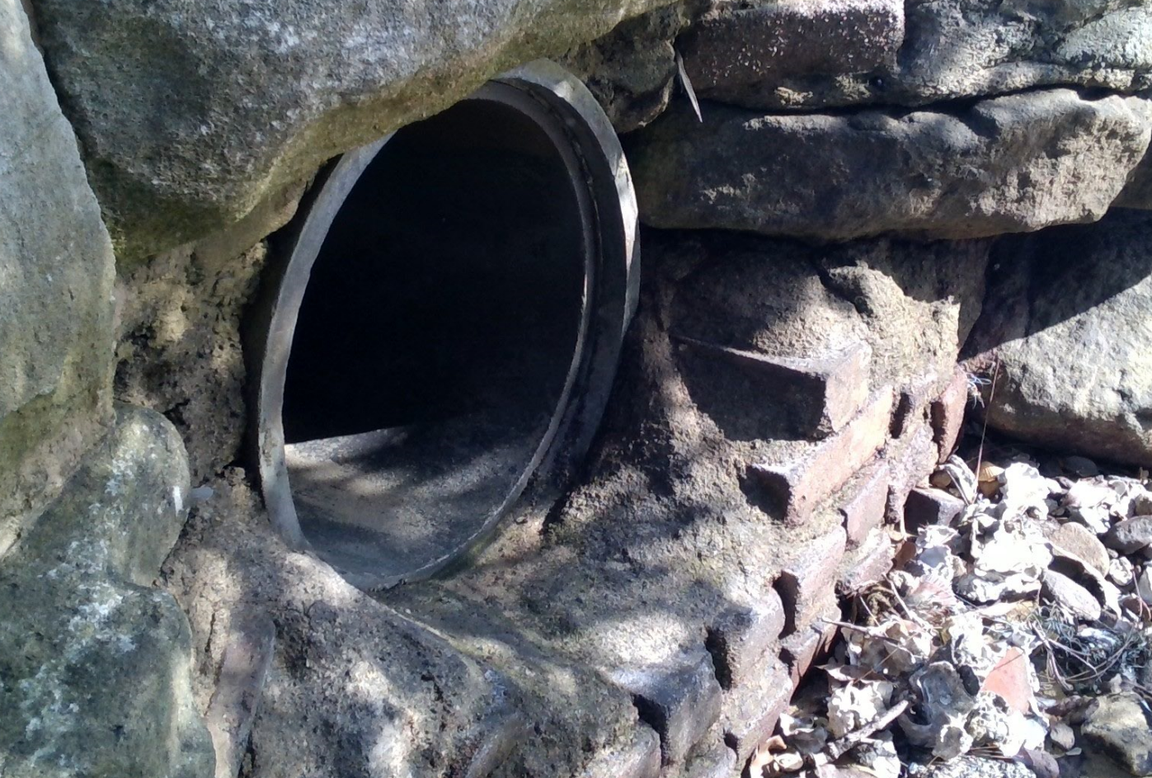
From shop to shore
The pipes usually lead to an outlet near a river, beach, dam or lake.

Slide 5
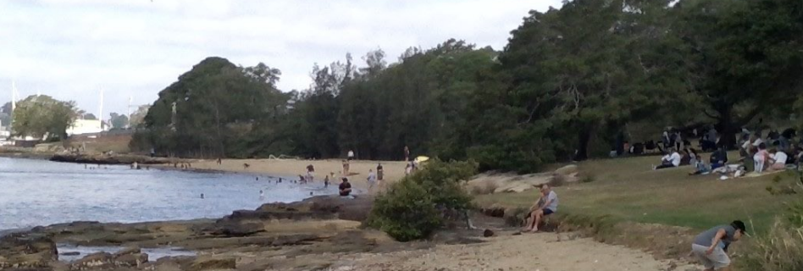
From shop to shore
Those outlets are often near places where people like to swim or play.

Slide 6
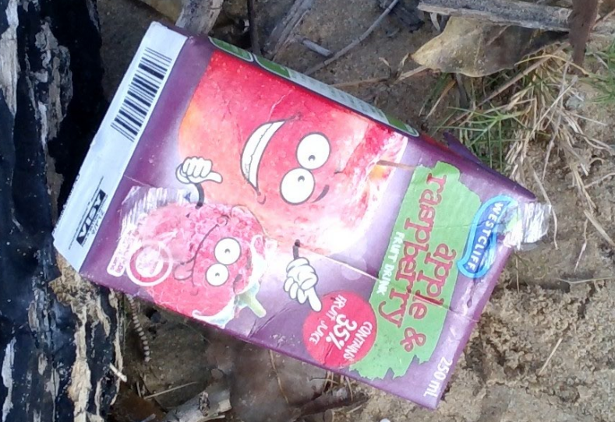
From shop to shore
Most plastic items float in water, so they can easily be carried to other places by tides, currents and the wind.

Slide 7
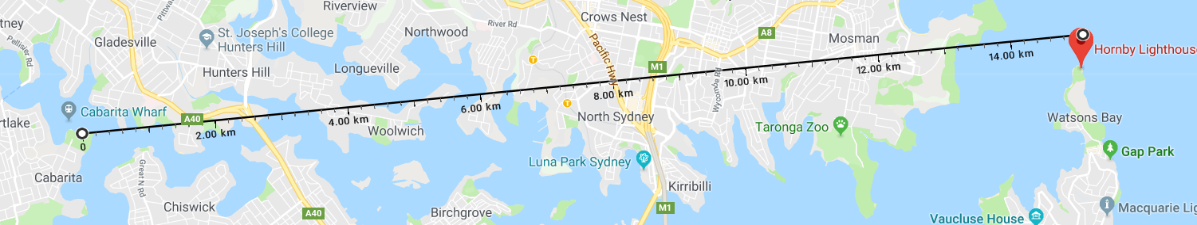
Waterways
Many waterways are connected to the open ocean.
Twice a day the outgoing tide takes rubbish out to sea.
Heavy rain can accelerate this journey.

Slide 8
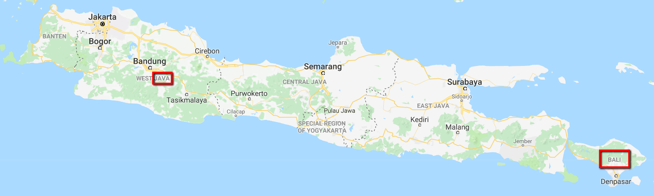
Oceans
Every monsoon season in recent years has taken vast amounts of plastic from the island of Java and dumped it on the beaches of Bali.
www.smh.com.au/world/bali-beaches-buried-in-rubbish-as-indonesia-battles-oceans-of-plastic-20171229-h0b8e9.html

Slide 9
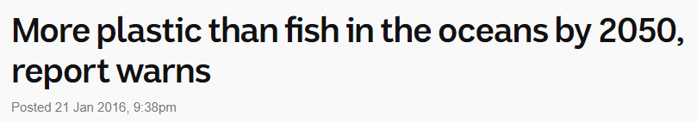
Oceans
According to one well-researched investigation, by the year 2050 the plastic in the ocean will weigh more than the fish.
www.abc.net.au/news/2016-01-21/more-plastic-than-fish-in-the-oceans-by-2050-report-warns/7105936

Slide 10
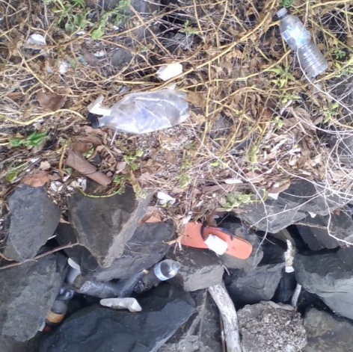
Pieces of plastic
In some places, the rubbish accumulates in large quantities, where it bakes in the sun and begins to break into smaller pieces.

Slide 11
Pieces of plastic
To some animals, small pieces of plastic floating near the surface of the ocean look like food. Red plastic bottle tops look like squid.
In some cases, parent birds feed this plastic to their chicks.
Many chicks are dying because there is so much plastic in their stomach it is impossible for them to eat enough fish to survive.
The chicks die from starvation.
www.youtube.com/watch?v=ju_2NuK5O-E
http://edition.cnn.com/2016/12/11/world/vanishing-walsh-plastic-albatross/index.html

Slide 12
276 pieces of plastic
One dead bird on Lord Howe Island had 234 pieces of plastic in its stomach.
The all-time record is 276!
http://www.abc.net.au/catalyst/stories/3583576.htm

Slide 13
Pieces of plastic
We humans eat plastic, too.
Tiny pieces of plastic, too small for us to see, make their way into the flesh of sea creatures that we then eat.
This 3-minute video explains how this happens:
www.abc.net.au/btn/story/s4425888.htm

Slide 14
Actions
What can we all do about this problem?

Slide 15

Actions
Be a volunteer on Clean Up Australia Day, held every year in March.
www.cleanupaustraliaday.org.au/about/about-the-event/clean-up-australia-day
Or better still, convince your principal to sign up!
www.cleanupaustraliaday.org.au/about/about-the-event/clean-up-australia-day

Slide 16
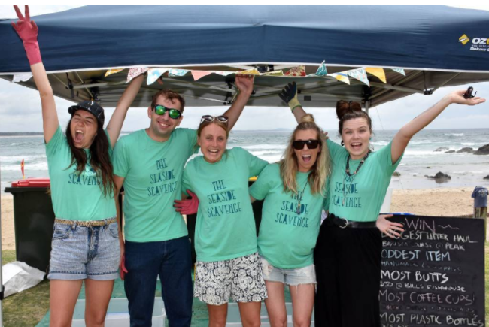
Actions
Start or join a movement like this one in Port Macquarie (NSW).
www.portnews.com.au/story/4838527/litter-blitz-nets-one-tonne-of-rubbish-video/

Slide 17
Actions
Say no to plastic straws and plastic cutlery.
In this distressing video, a plastic straw is removed from the nostril of a sea turtle.
www.youtube.com/watch?v=vJmi_gwziy4
This one shows a plastic fork being removed from a turtle on a beach in Portugal.
www.dailymail.co.uk/news/article-3353963/Rescue-crew-remove-plastic-fork-sea-turtle-s-nose-months-turtle-pictured-straw-nostril.html

Slide 18
Actions
Collect and display plastic pollution, like these people who found 452 plastic straws in one day in the ocean pool at Manly and published the photos.
www.somanly.org/news/
Stop using single-use plastic drinking straws.
www.dailytelegraph.com.au/newslocal/northern-beaches/the-last-straw-for-environmentalists-picking-up-rubbish-at-manly-cove/news-story/695b1853906259d0aa31fdb767173663
Buy your food at shops that are trying to reduce the use of plastic.
www.dailytelegraph.com.au/newslocal/northern-beaches/manly-restaurant-hemingways-replaces-plastic-straws-with-metal-straws/news-story/0d5221fffcb10c6db6357f3ea7fbec5d
Convince the school canteen in your school to stop using plastic straws and plastic cutlery.

Slide 19
Actions
Say no to plastic bags.
In the waters all around Australia (and even in Sydney Harbour) turtles and other animals eat plastic bags, because they look like jellyfish.
www.abc.net.au/news/2017-02-12/sydney-harbour-hidden-plastics-threatening-endangered-turtles/8263368

Slide 20
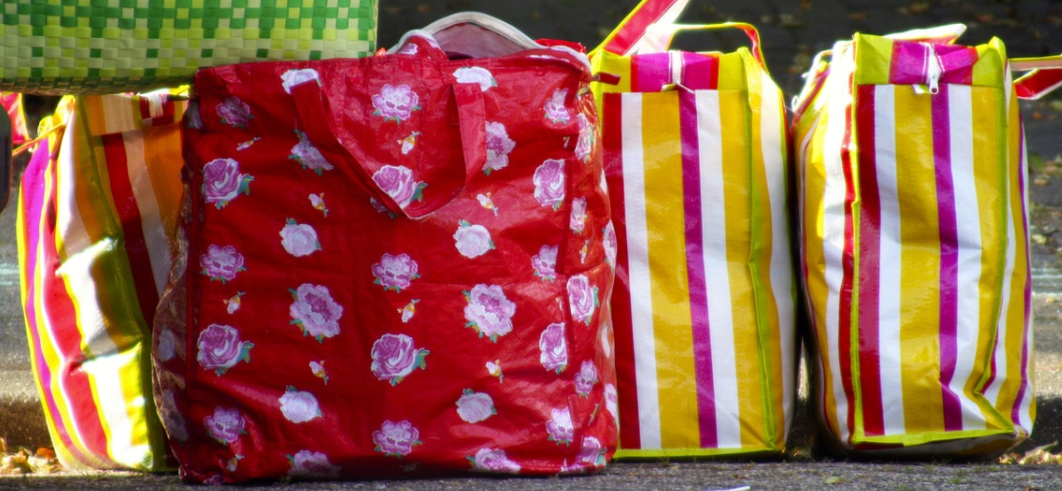
Actions
Make the switch to reusable shopping bags.

Slide 21
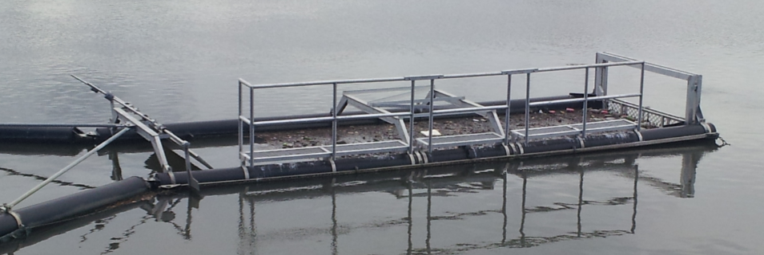
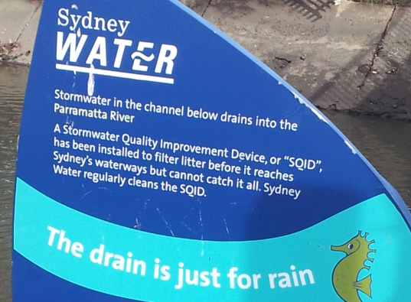
Other actions
Find out if your local council is installing gross pollutant traps called ‘litter booms’.
These stop floating debris going from drains into rivers and then out to sea.

Slide 22
Case Study: The Cooks River, Sydney
Where does the Cooks River start?
Into which body of water does it flow?
How long is the Cooks River?
Who is it named after?
What was it originally called by the local Indigenous people?
How big is the catchment area of drains which flow into the Cooks River?
How many people live in that catchment area?
In 1770 it was described as ‘a very fine stream of fresh water’. What has caused the water quality to be poor in the time since then?
What is being done to improve water quality? Collect some photographs which show the degraded state of the river.

Slide 23
Case Study: The Cooks River, Sydney
Find some photos of the Cooks River litter boom.
Read this article about the litter boom and write down three ‘mathematical facts’ from it:
www.dailytelegraph.com.au/newslocal/the-express/sydney-water-urges-residents-to-recycle-and-reuse-as-it-removes-thousands-of-plastic-bottles/news-story/f8666da4ffbe1b48526b51e1f0824512

Slide 24
Investigation 1
This spreadsheet shows how much rubbish was removed from the litter boom every month for 37 months. The rubbish removed from the litter boom is measured in cubic metres.
MI_Coasts_Activity3_ShipShore_DataSet1_Booms.xlsx
How many cubic metres of rubbish was trapped in the litter boom?
How many times would that rubbish fill your classroom?
If that rubbish was spread evenly on a tennis court, how deep would the rubbish be?
If the rubbish was piled into a cube, how long would each edge of the cube be?

Slide 25
Investigation 2
Read this information about Gross Pollutant Traps (GPTs)
www.innerwest.nsw.gov.au/environment/water-and-catchments/gross-pollutant-traps
The next slide is a summary of the GPTs in the Cooks River area.

Slide 26
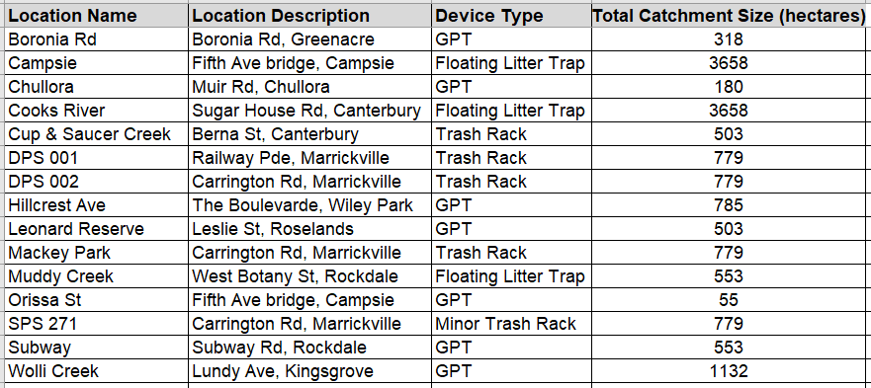
Investigation 2

Slide 27
Investigation 2
This spreadsheet shows how much litter was captured and removed from GPTs. There are 544 rows of data in the spreadsheet.
MI_Coasts_Activity3_ShopShore_DataSet2_GPTs.xlsx
On average, at which location is the highest percentage of ‘Other Rubbish’ trapped?
On average, at which location is the largest volume of rubbish trapped?
According to the previous slide, some GPTs collect rubbish from larger areas than others. Which location traps the greatest volume of rubbish per reading per hectare of catchment?

Slide 28
Investigating the Maths Inside
Maths Inside is a project led by University of Technology Sydney, and funded by the Commonwealth Department of Education and Training under the Australian Maths and Science Partnership Program.
The aim of Maths Inside is to increase engagement of secondary school students
in mathematics, by using rich tasks that show the ways it is used in real world applications. To find out more about this project and other AMSPP resources,
please go to http://dimensions.aamt.edu.au
© Maths Inside 2016 except where otherwise indicated. This document may be
used, reproduced, communicated and adapted free of charge for non-commercial educational purposes provided all acknowledgements associated with the material are retained. Maths Inside is a UTS project in collaboration with CSIRO and AAMT.

