Slide 1
How might you split the array?

Slide 2
How might you split the array?

Slide 3
How might you split the array?
I know 6 rows of 5 is 30.

Slide 4
How might you split the array?
I know 6 rows of 5 is 30.
I know 6 rows of 2 is 12.

Slide 5
How might you split the array?
I know 6 rows of 5 is 30.
I know 6 rows of 2 is 12.
So 6 rows of 7 is 42. 6 × 7 = 42

Slide 6
How might you split the array?
Is there another way?

Slide 7
How might you split the array?
I know! 6 rows of 5 is 30

Slide 8
How might you split the array?
I know 5 rows of 7 is 35.
I know 5 rows of 7 is 35

Slide 9
How might you split the array?
I know 5 rows of 7 is 35.
I know 5 rows of 7 is 35
I know 1 row of 7 is 7.

Slide 10
How might you split the array?
I know 5 rows of 7 is 35.
I know 5 rows of 7 is 35
I know 1 rows of 7 is 7.
So 6 rows of 7 is 42. 6 × 7 = 42

Slide 11
How might you split the array?
Is there another way?

Slide 12
How might you split the array?

Slide 13
How might you split the array?
I know 6 rows of 6 is 36.

Slide 14
How might you split the array?
I know 6 rows of 6 is 36.
I know 6 rows of 1 is 6.

Slide 15
How might you split the array?
I know 6 rows of 6 is 36.
So 6 rows of 7 is 42.
6 × 7 = 42
I know 6 rows of 1 is 6.

Slide 16
How might you split the array?
How could you split this array?

Slide 17
How might you split the array?
4 rows of 5
4 × 5 = 20
4 rows of 3
4 × 3 = 12

Slide 18
How might you split the array?
4 rows of 5
4 × 5 = 20
4 rows of 3
4 × 3 = 12
4 rows of 8
4 × 8 = 32

Slide 19
How might you split the array?
Is there another way?

Slide 20
How might you split the array?

Slide 21
How might you split the array?
4 rows of 4
4 × 4 = 16
4 rows of 4
4 × 4 = 16

Slide 22
How might you split the array?
4 rows of 4
4 × 4 = 16
4 rows of 4
4 × 4 = 16
4 rows of 8
4 × 8 = 32

Slide 23
How might you split the array?
4 rows of 4
4 × 4 = 16
4 rows of 4
4 × 4 = 16
4 rows of 8
4 × 8 = 32
Splitting arrays into known parts provides an opportunity for square numbers to be identified and explored in relation to the original fact and lead to generalisations.

Slide 24
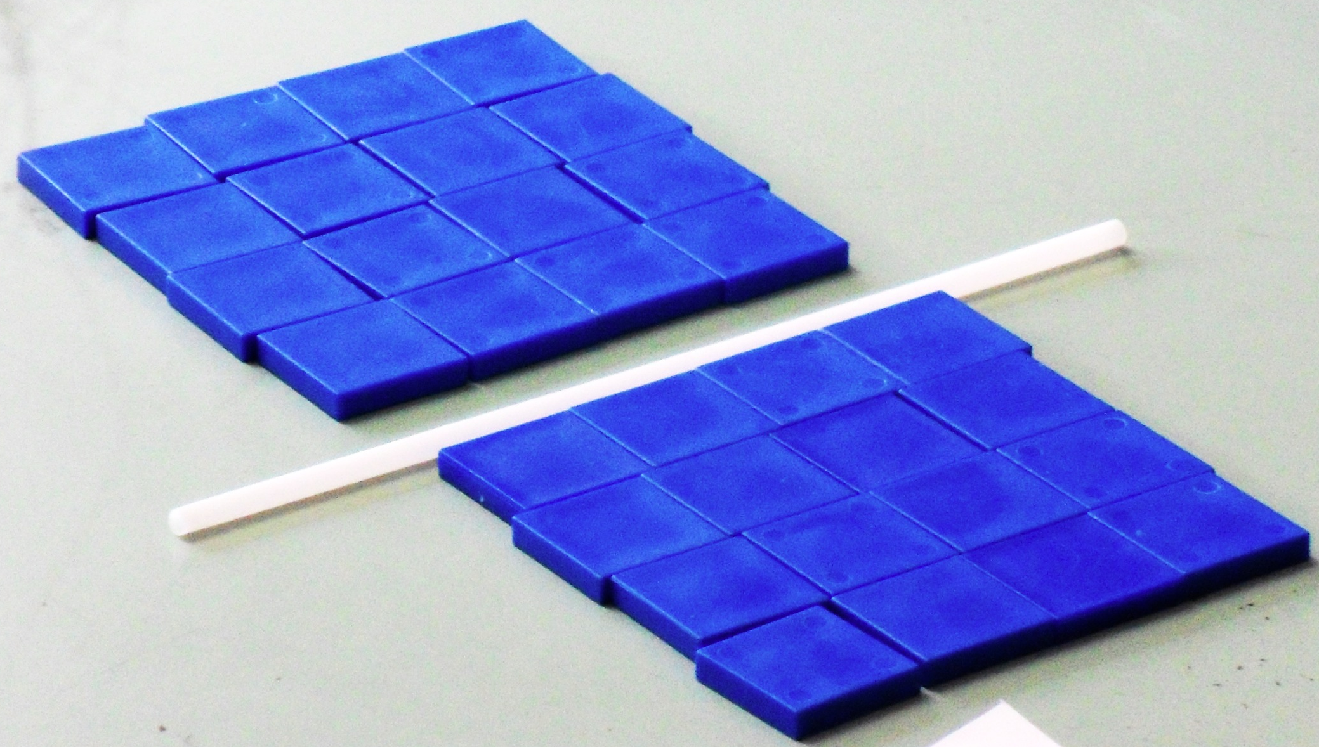
How might you split the array?
Straws are useful to show the
way an array has been split.
8 × 4 = (4 × 4) + (4 × 4)

Slide 25
Use colour to show the different ways to split an array in to the related known facts.
This enables students to see connections such as doubling and halving, and square numbers.
How might you split the array?

Slide 26
Splitting arrays into known facts
3 rows of 12 3 × 12
3 × 10 + 3 × 2

Slide 27
Splitting arrays into known facts
3 × 12
(3 × 10) + (3 × 2)
(3 × 6) + (3 × 6)
6 × 6

Slide 28
Splitting arrays into known facts
3 × 12
(3 × 10) + (3 × 2)
(3 × 6) + (3 × 6)
(3 × 4) + ( 3 × 4) + (3 × 4)
6 × 6
(5 × 4) + (4 × 4)
(6 × 4) + (3 × 4)

